Slide 1
The African Monsoon Recent Evolution and Current Status
Include Week-1 and Week-2 Outlooks
Update prepared by
Climate Prediction Center / NCEP
19 June 2017
For more information, visit:
http://www.cpc.ncep.noaa.gov/products/Global_Monsoons/African_Monsoons/precip_monitoring.shtml

Slide 2
Outline
Highlights
Recent Evolution and Current Conditions
NCEP GEFS Forecasts
Summary

Slide 3
Highlights:
Last 7 Days
During the past seven days, rainfall was above-average over portions of West and Central Africa. In contrast, suppressed rainfall prevailed in the Lake Victoria region.
Week-1 outlooks call for an increased chance for above-average rainfall over many places in the Gulf of Guinea and the neighboring areas of the Sahel countries, and western Ethiopia. In contrast, there is an increased chance for below-average rainfall across parts of eastern CAR, South Sudan, northeastern DRC and Uganda.

Slide 4
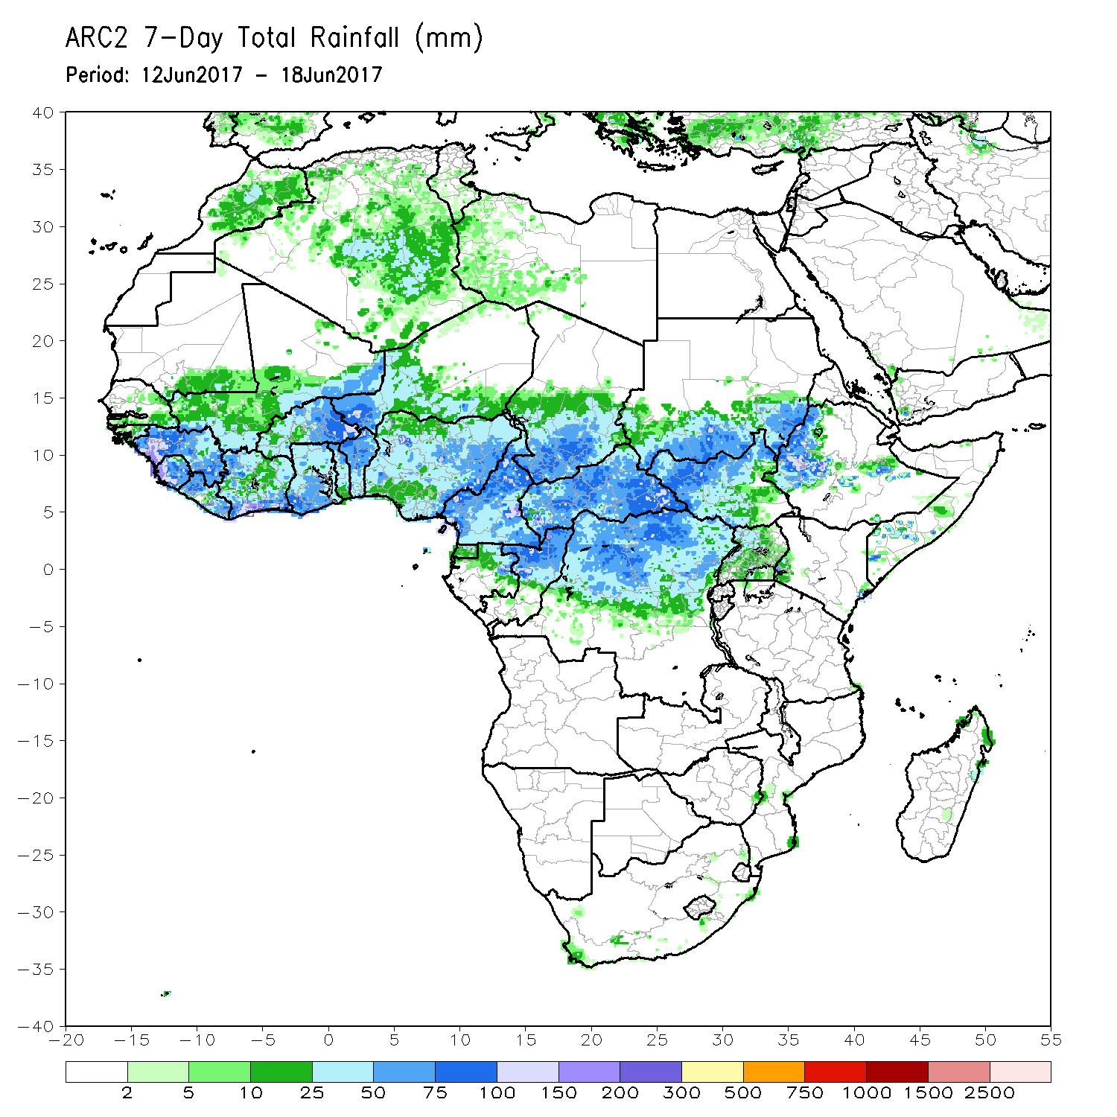
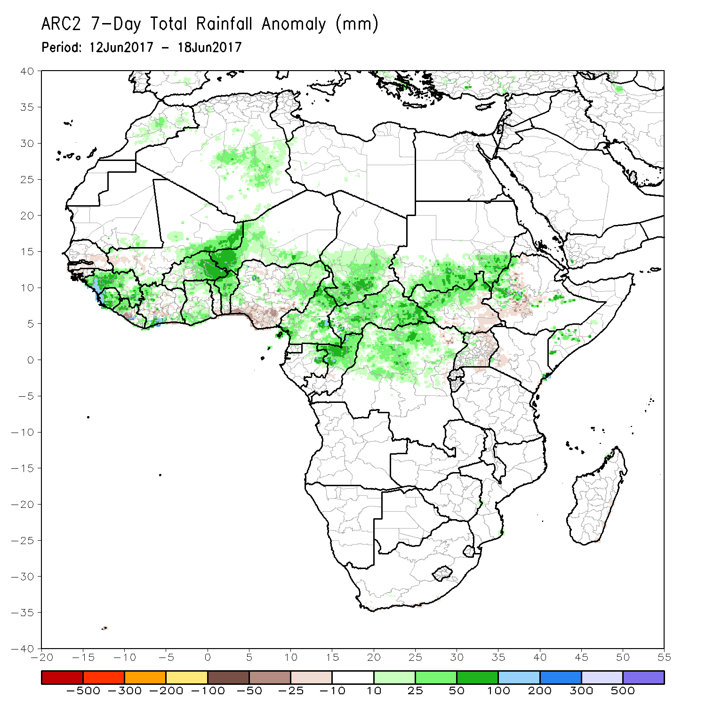
Rainfall Patterns: Last 7 Days
During the past seven days, above-average rainfall was observed over much of Guinea, Sierra Leone, western Liberia, parts of Cote d’Ivoire and Ghana, Burkina Faso, western Niger, Benin, parts of Nigeria, Cameroon, northern Congo-Brazzaville, southern Chad, CAR, northern DRC, parts of South Sudan and Sudan, and local areas in Ethiopia and Somalia. In contrast, rainfall was below-average over parts of eastern Senegal and southern Mali, local areas in Liberia and Cote d’Ivoire, southern Nigeria, southern South Sudan, Uganda, and local areas in Ethiopia and western Kenya.

Slide 5
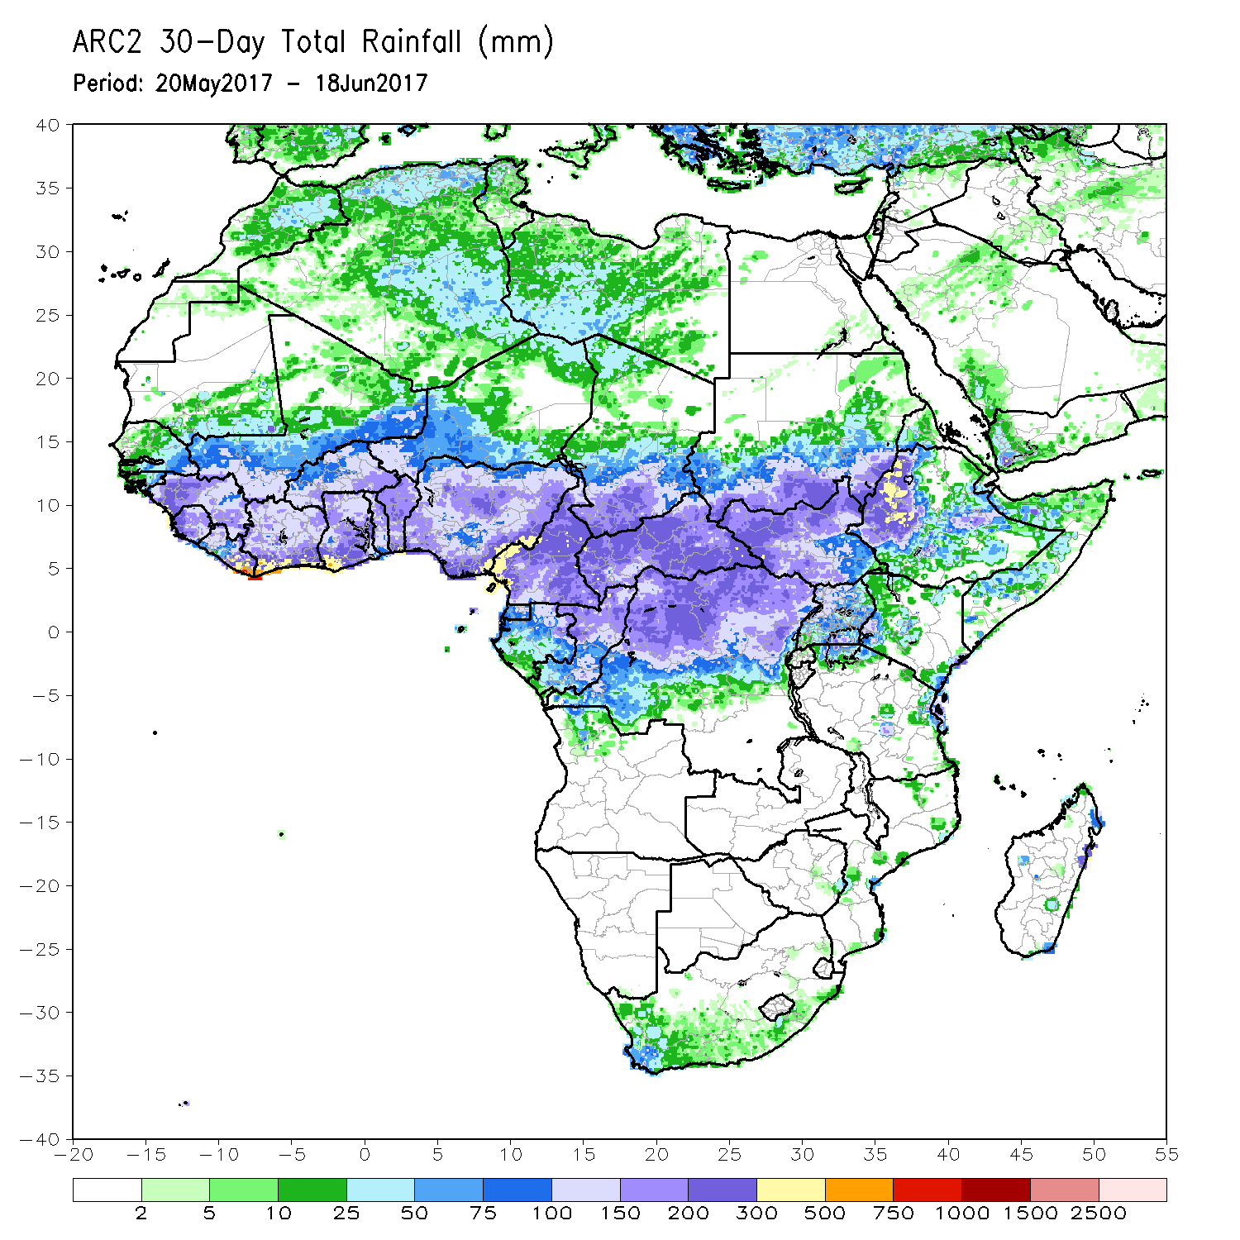
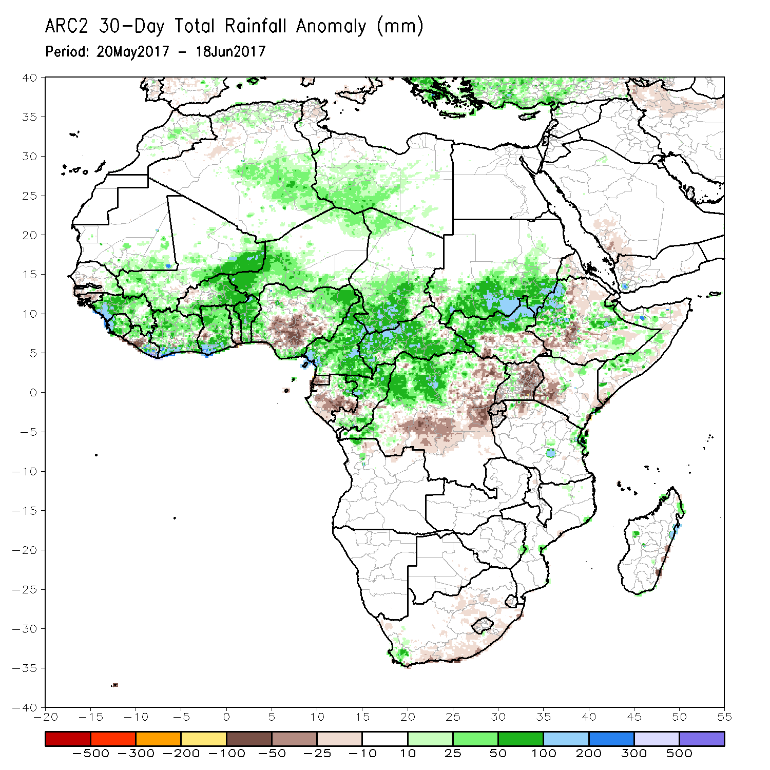
Rainfall Patterns: Last 30 Days
During the past 30 days, rainfall was above-average over much of Guinea, Sierra Leone, parts of Mali, Cote d’Ivoire, Burkina Faso, Ghana, western Niger, Benin, portions of Nigeria, Cameroon, Congo-Brazzaville, southern Chad, CAR, western and northern DRC, South Sudan, southern Sudan, portions of Ethiopia, and local areas in Somalia. In contrast, central and southern Nigeria, Equatorial Guinea, much of Gabon, central and eastern DRC, Uganda, parts of Ethiopia and Kenya, Uganda, and local areas in Somalia had below-average rainfall.

Slide 6
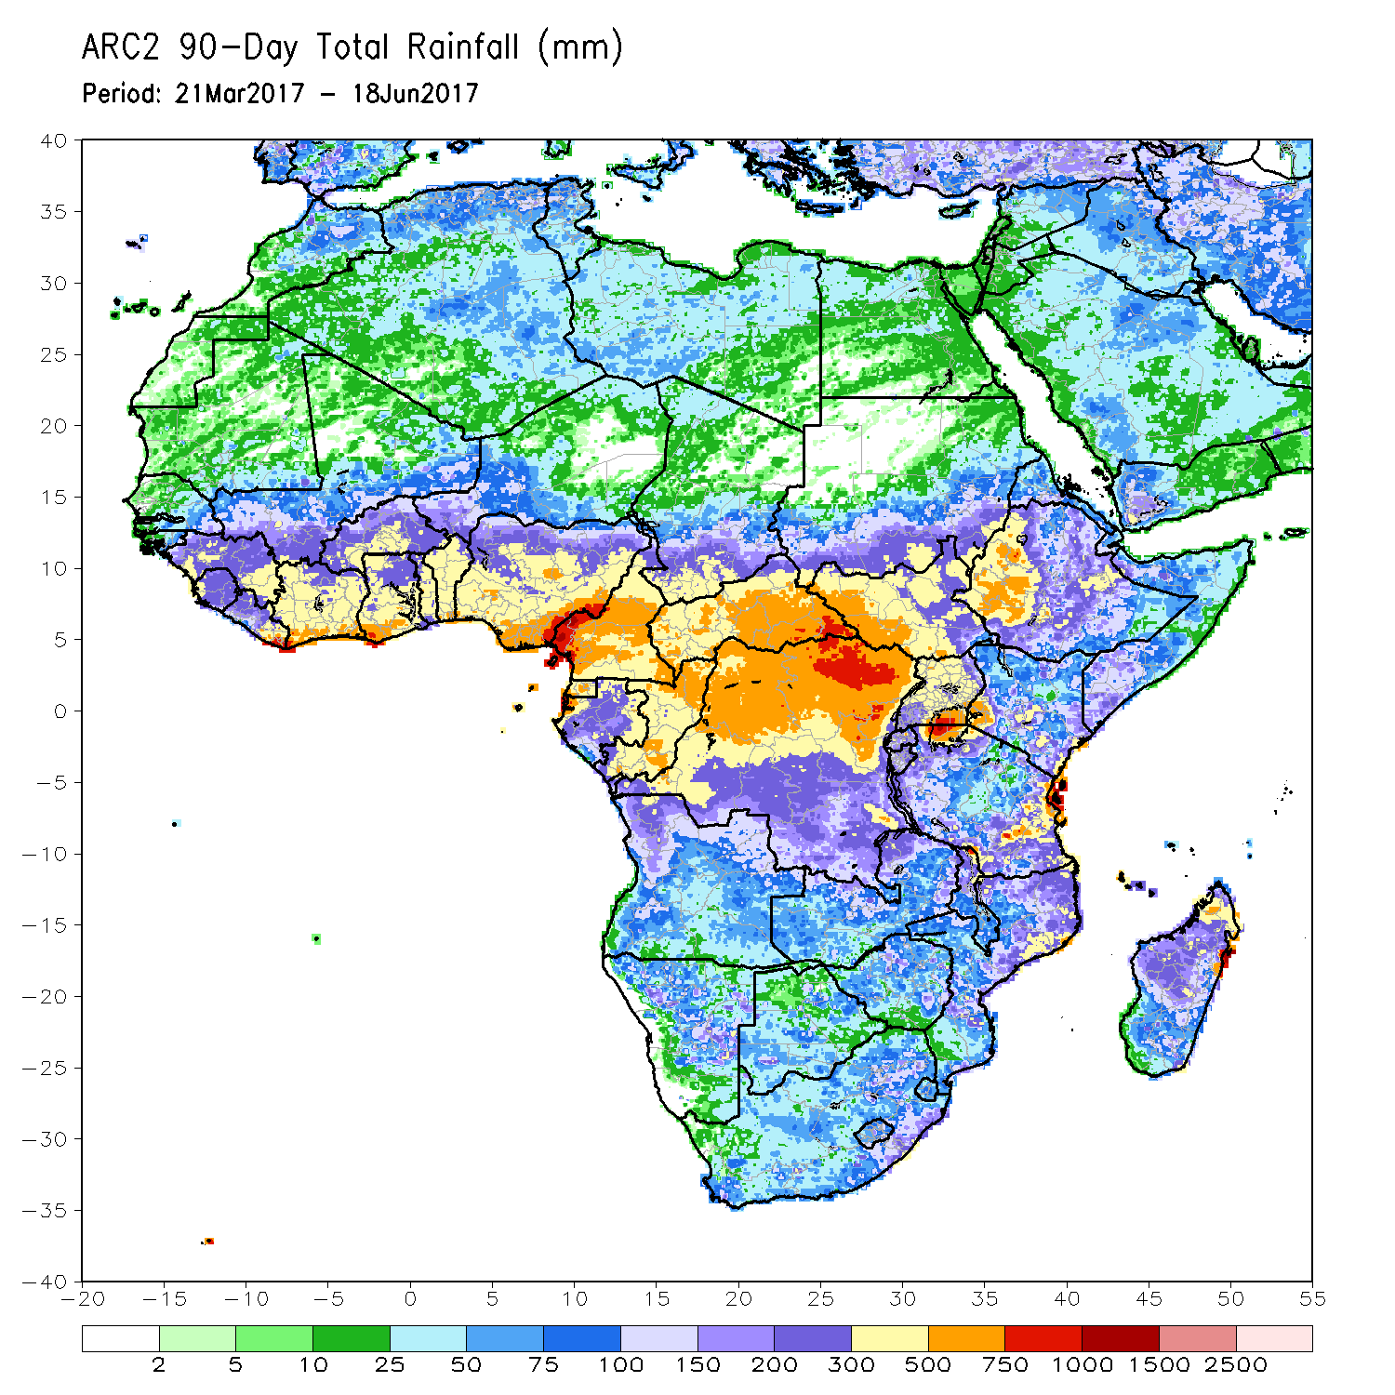
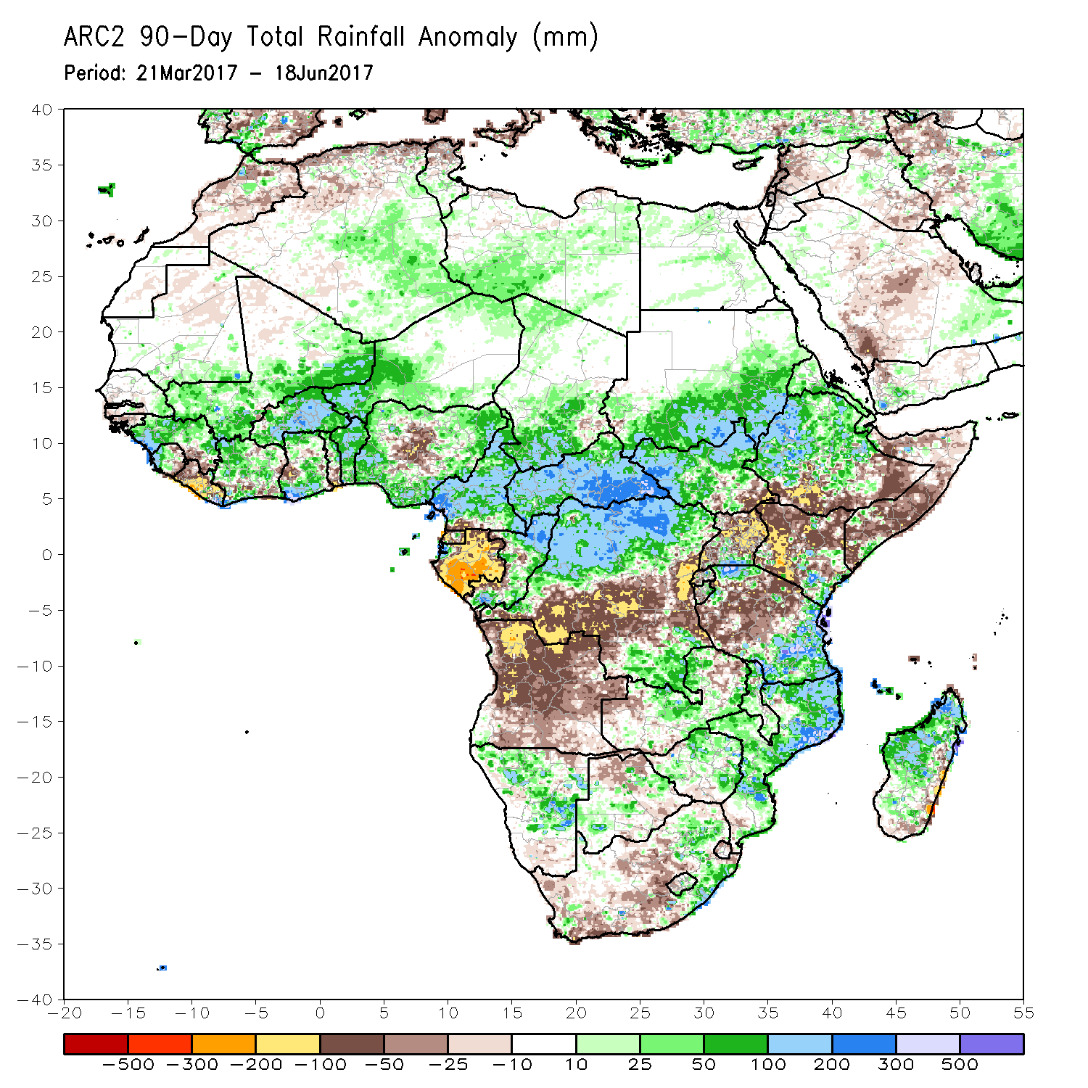
Rainfall Patterns: Last 90 Days
During the past 90 days, rainfall was above-average over much of Guinea, Sierra Leone, Mali, portions of Cote d’Ivoire and Ghana, much of Burkina Faso, western Niger, Benin, portions of Nigeria, Cameroon, parts of Congo-Brazzaville, much of CAR, southern Chad, portions of DRC, southern and eastern Sudan, South Sudan Republic, many parts of Ethiopia, portions of Tanzania, much of Namibia, local areas in Zambia and Zimbabwe, eastern South Africa, Malawi, many parts of Mozambique and Madagascar. In contrast, below-average rainfall was observed over Liberia, local areas in Ghana, Togo, central Nigeria, Gabon, much of Angola, parts of DRC, parts of southern and southeastern Ethiopia, Kenya, parts of Tanzania, Uganda, Somalia, parts of Zambia and Botswana, and portions of South Africa.

Slide 7
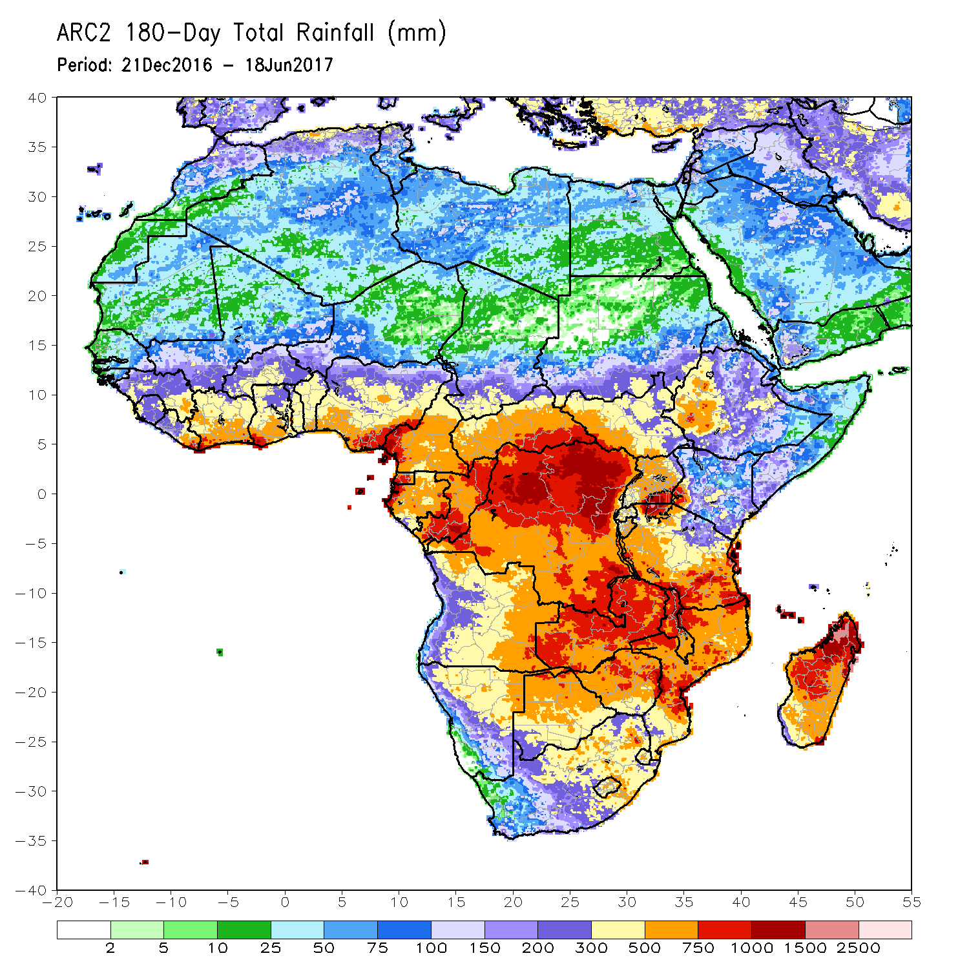
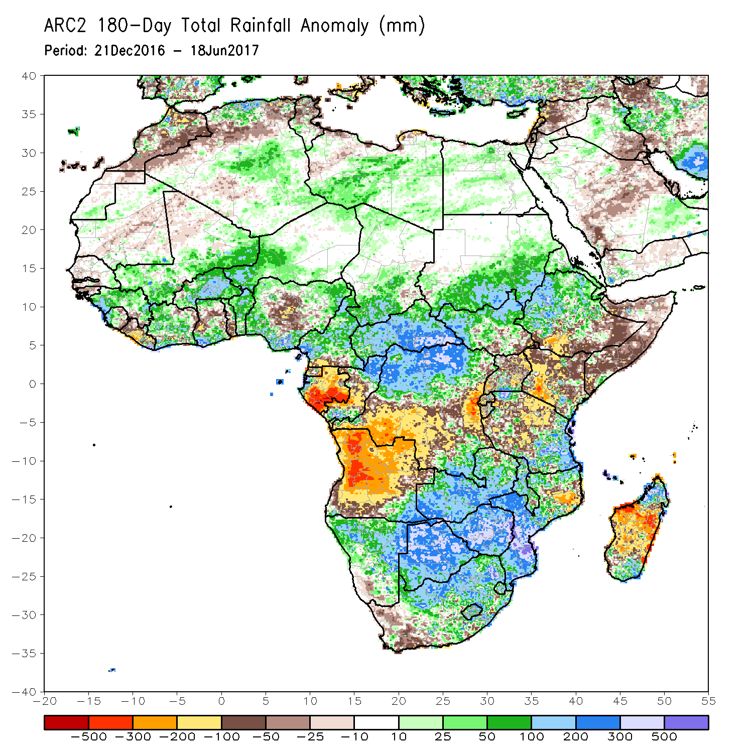
Rainfall Patterns: Last 180 Days
During the past 180 days, rainfall was above-average over many parts of Mali, Sierra Leone, Guinea-Conakry, Cote d’Ivoire, Burkina Faso, southern Ghana, western Niger, Benin, portions of Nigeria, much of Cameroon, southern Chad, CAR, much of South Sudan, Ethiopia, southern and eastern Sudan, parts of Congo-Brazzaville, local areas in southern Angola, portions of DRC, Namibia, Botswana, Zimbabwe, Malawi, much of Zambia, South Africa, Lesotho, Swaziland, many parts of Mozambique, portions of Tanzania, and northern and southern Madagascar. In contrast, below-average rainfall was observed over eastern Sierra Leone, Liberia, portions of Ghana, Togo, central Nigeria, Gabon, central Congo-Brazzaville, portions of DRC, Angola, parts of southern Ethiopia, Somalia, Kenya, parts of Uganda and Tanzania, southwestern South Africa, portions of northern Mozambique, and portions of Madagascar.

Slide 8
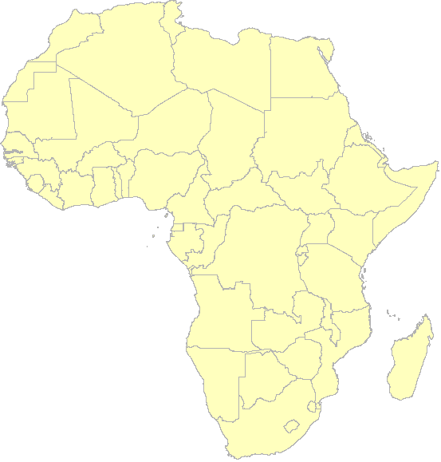
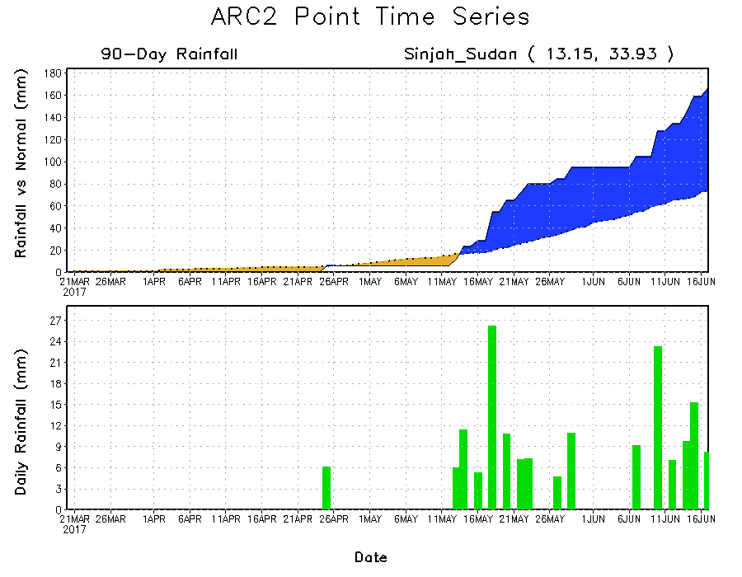
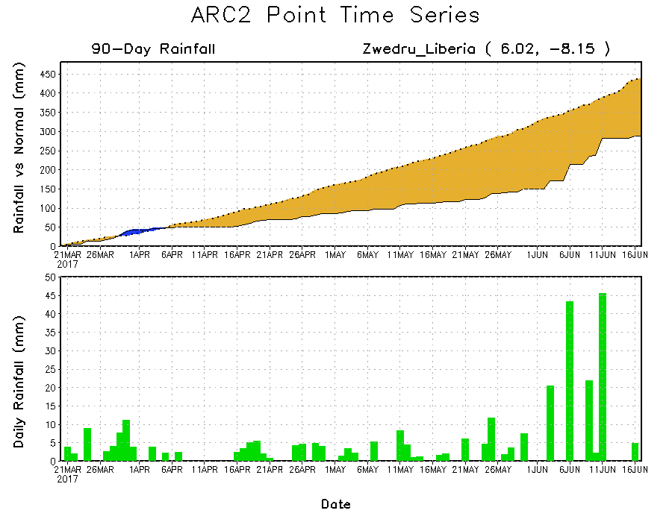
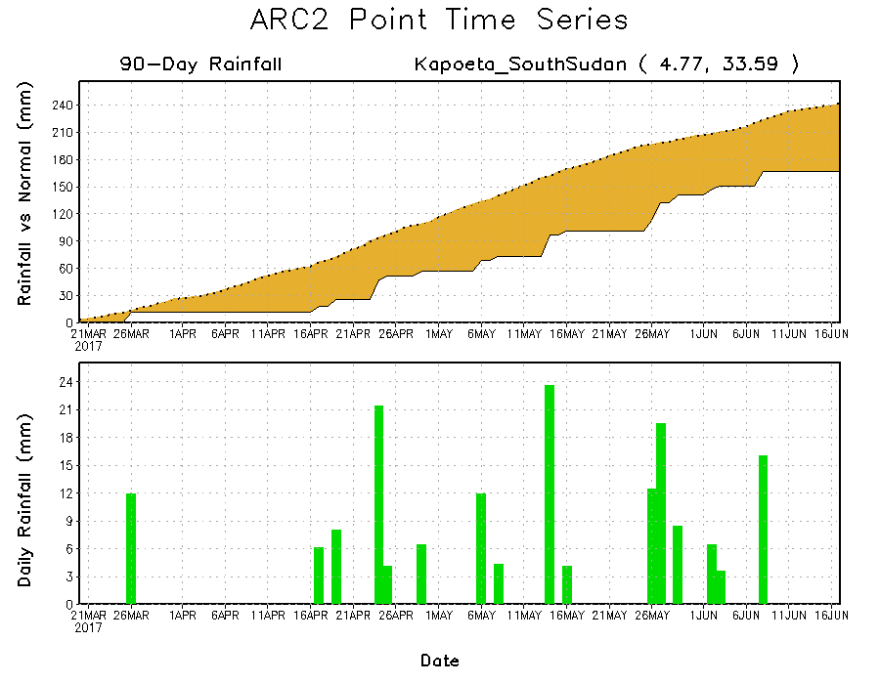
Recent Rainfall Evolution
Daily evolution of rainfall over the last 90 days at selected locations shows that seasonal total rainfall remained below-average over parts of Liberia (bottom left) and South Sudan (bottom right). In contrast, moderate to locally heavy rainfall sustained moisture surpluses over parts of Sudan (top right).

Slide 9
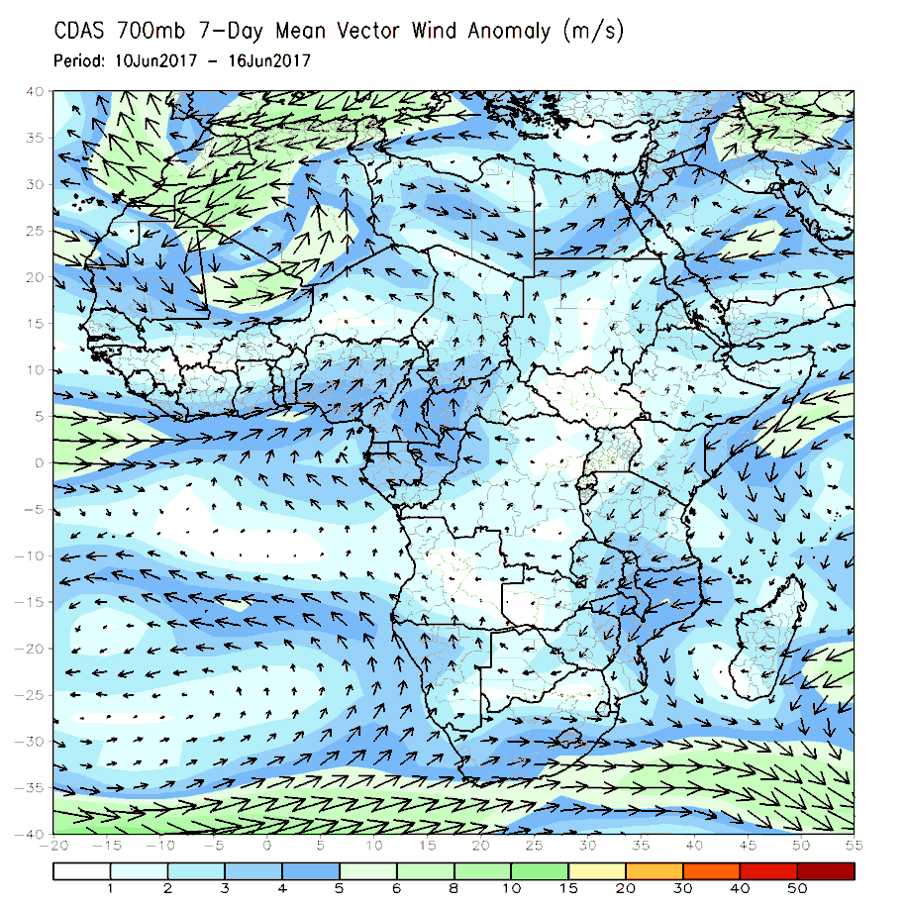
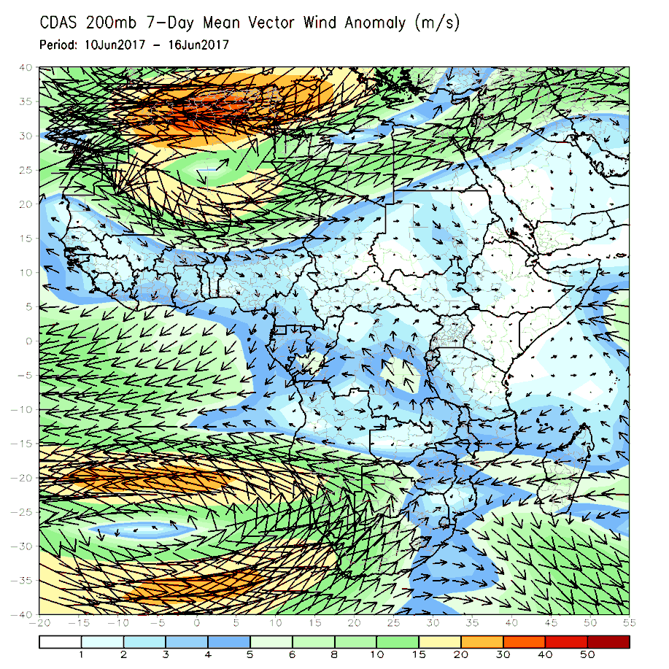
Atmospheric Circulation:
Last 7 Days
Anomalous lower-level southerly flow across the Gulf of Guinea region with its cyclonic turning may have contributed to the observed above-average rainfall in the region (left panel). Upper-level anomalies (right panel) show southward bend of the subtropical westerly jet across northern Africa.

Slide 10
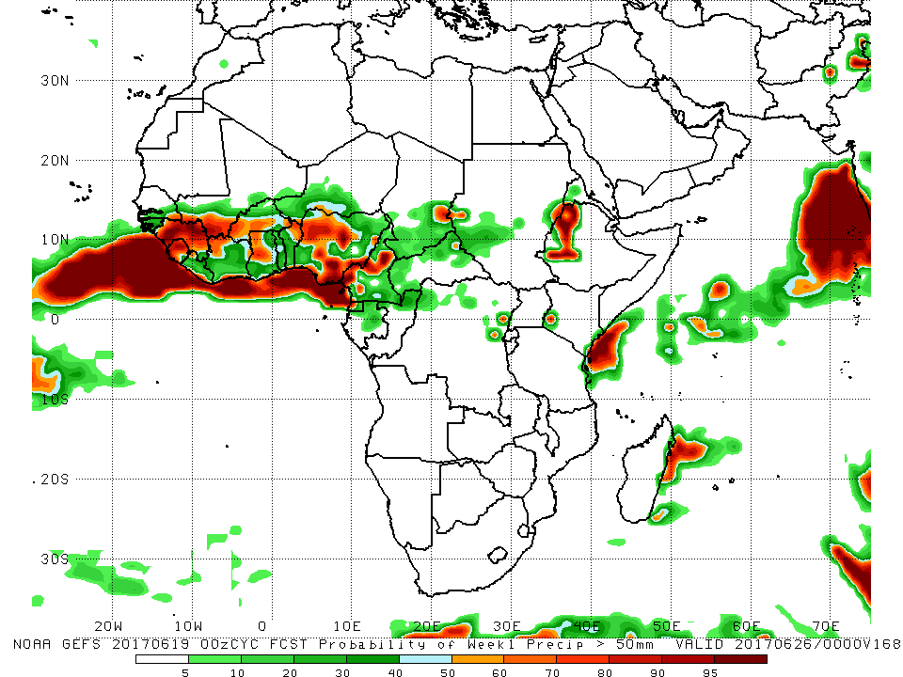
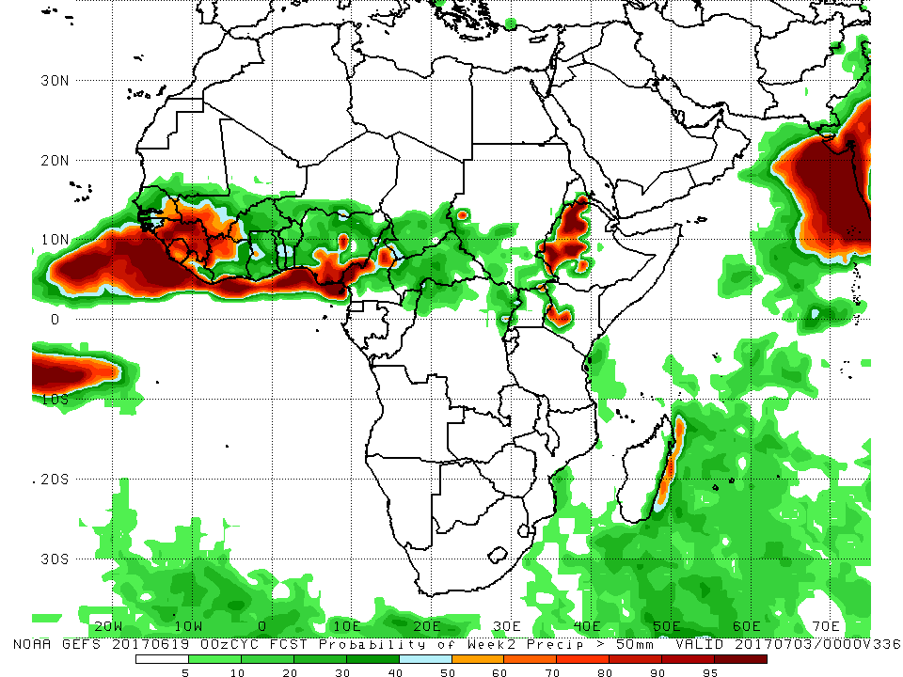
NCEP GEFS Model Forecasts
Non-Bias Corrected Probability of
precipitation exceedance
Week-1: Valid 20 – 26 June 2017
Week-2: Valid 27 June – 3 July 2017
For week-1 (left panel), there is an increased chance for weekly rainfall totals to exceed 50mm across the Gulf of Guinea and the neighboring areas of the Sahel counties, and western Ethiopia. For week-2 (right panel), there is an increased chance for weekly rainfall totals to exceed 50mm over eastern Senegal, Guinea, Sierra Leone, southwestern Mali, northern Cote d’Ivoire, western Burkina Faso, southern Nigeria, northern Cameroon, western Ethiopia and western Kenya.

Slide 11
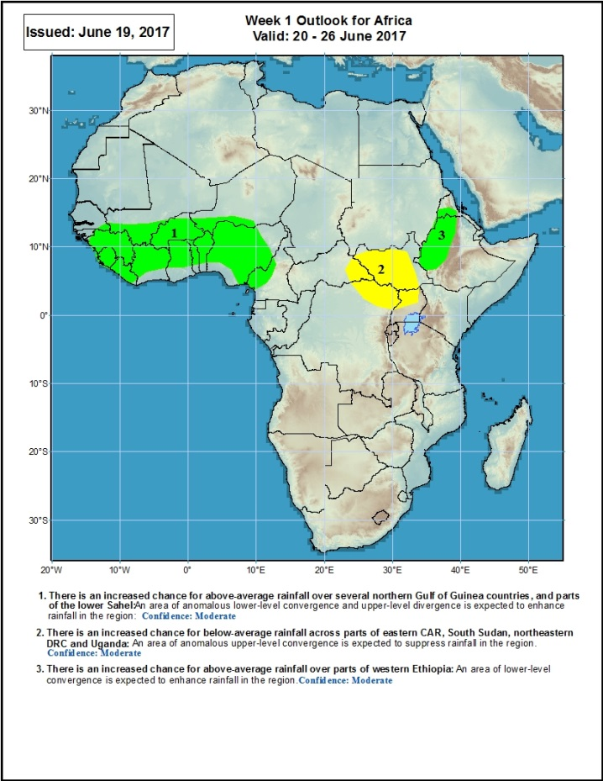
Week-1 Precipitation Outlooks
20 – 26 June 2017
There is an increased chance for above-average rainfall over several northern Gulf of Guinea countries, and parts of the lower Sahel: An area of anomalous lower-level convergence and upper-level divergence is expected to enhance rainfall in the region. Confidence: Moderate
There is an increased chance for below-average rainfall across parts of eastern CAR, South Sudan, northeastern DRC and Uganda: An area of anomalous upper-level convergence is expected to suppress rainfall in the region. Confidence: Moderate
There is an increased chance for above-average rainfall over parts of western Ethiopia: An area of lower-level convergence is expected to enhance rainfall in the region. Confidence: Moderate

Slide 12
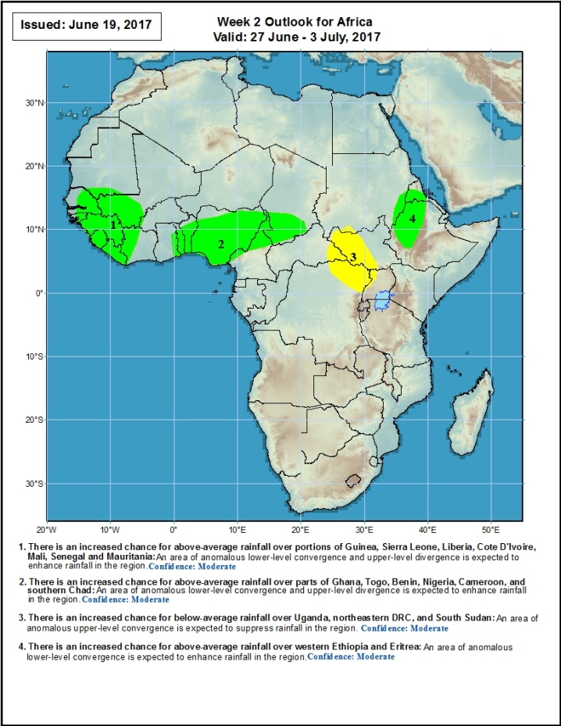
Week-2 Precipitation Outlooks
27 June – 3 July 2017
There is an increased chance for above-average rainfall over portions of Guinea, Sierra Leone, Liberia, Cote D'Ivoire, Mali, Senegal and Mauritania: An area of anomalous lower-level convergence and upper-level divergence is expected to enhance rainfall in the region. Confidence: Moderate
There is an increased chance for above-average rainfall over parts of Ghana, Togo, Benin, Nigeria, Cameroon, and southern Chad: An area of anomalous lower-level convergence and upper-level divergence is expected to enhance rainfall in the region. Confidence: Moderate
There is an increased chance for below-average rainfall over northeastern DRC, parts of eastern CAR, western South Sudan, and northwestern Uganda: An area of anomalous upper-level convergence is expected to suppress rainfall in the region. Confidence: Moderate
There is an increased chance for above-average rainfall over western Ethiopia and Eritrea: An area of anomalous lower-level convergence is expected to enhance rainfall in the region. Confidence: Moderate

Slide 13
Summary
During the past seven days, above-average rainfall was observed over much of Guinea, Sierra Leone, western Liberia, parts of Cote d’Ivoire and Ghana, Burkina Faso, western Niger, Benin, parts of Nigeria, Cameroon, northern Congo-Brazzaville, southern Chad, CAR, northern DRC, parts of South Sudan and Sudan, and local areas in Ethiopia and Somalia. In contrast, rainfall was below-average over parts of eastern Senegal and southern Mali, local areas in Liberia and Cote d’Ivoire, southern Nigeria, southern South Sudan, Uganda, and local areas in Ethiopia and western Kenya.
During the past 30 days, rainfall was above-average over much of Guinea, Sierra Leone, parts of Mali, Cote d’Ivoire, Burkina Faso, Ghana, western Niger, Benin, portions of Nigeria, Cameroon, Congo-Brazzaville, southern Chad, CAR, western and northern DRC, South Sudan, southern Sudan, portions of Ethiopia, and local areas in Somalia. In contrast, central and southern Nigeria, Equatorial Guinea, much of Gabon, central and eastern DRC, Uganda, parts of Ethiopia and Kenya, Uganda, and local areas in Somalia had below-average rainfall.
During the past 90 days, rainfall was above-average over much of Guinea, Sierra Leone, Mali, portions of Cote d’Ivoire and Ghana, much of Burkina Faso, western Niger, Benin, portions of Nigeria, Cameroon, parts of Congo-Brazzaville, much of CAR, southern Chad, portions of DRC, southern and eastern Sudan, South Sudan Republic, many parts of Ethiopia, portions of Tanzania, much of Namibia, local areas in Zambia and Zimbabwe, eastern South Africa, Malawi, many parts of Mozambique and Madagascar. In contrast, below-average rainfall was observed over Liberia, local areas in Ghana, Togo, central Nigeria, Gabon, much of Angola, parts of DRC, parts of southern and southeastern Ethiopia, Kenya, parts of Tanzania, Uganda, Somalia, parts of Zambia and Botswana, and portions of South Africa.
Week-1 outlooks call for an increased chance for above-average rainfall over many places in the Gulf of Guinea and the neighboring areas of the Sahel countries, and western Ethiopia. In contrast, there is an increased chance for below-average rainfall across parts of eastern CAR, South Sudan, northeastern DRC and Uganda.

